Slide 1
THE INDUSTRIES AND THE EMPLOYEES SALARY INSIGHTS
Name: Cheran T
Batch: March – 2025
Course: DADS
Notes:
Be specific and direct in the title. Use the subtitle to give the specific context of the speech.
-The goal should be to capture the audience’s attention which can be done with a quote, a startling statistic, or fact. It is not necessary to include this attention getter on the slide.

Slide 2
The Objective
Objectives are :
The project focuses on uncovering trends and relationships between years of experience and salary levels by performing data cleaning , aggregation and visualization.
Understand and visualize salary patterns
Enabling user and audience for better understanding
To ensure which trending job title for advancement
Notes:
Use the background points to post details that are not common knowledge, or that the audience will need to understand the context of the speech.
-Do not read these main points from the PowerPoint, instead elaborate on these points during the speech.

Slide 3
Data Cleaning and Pre-processing
Size
Key columns
Source
Handling missing values
Standardizing
Adding outliers
Notes:
The counterargument should be the most common argument against the topic. The goal for this slide is to address the counterargument in such a way as to actually strengthen the original topic. Be sure to address each piece of evidence against the topic. As you address each piece of evidence elaborate on the text found on the slide. Remember to transition to the final slide, the action step.

Slide 4
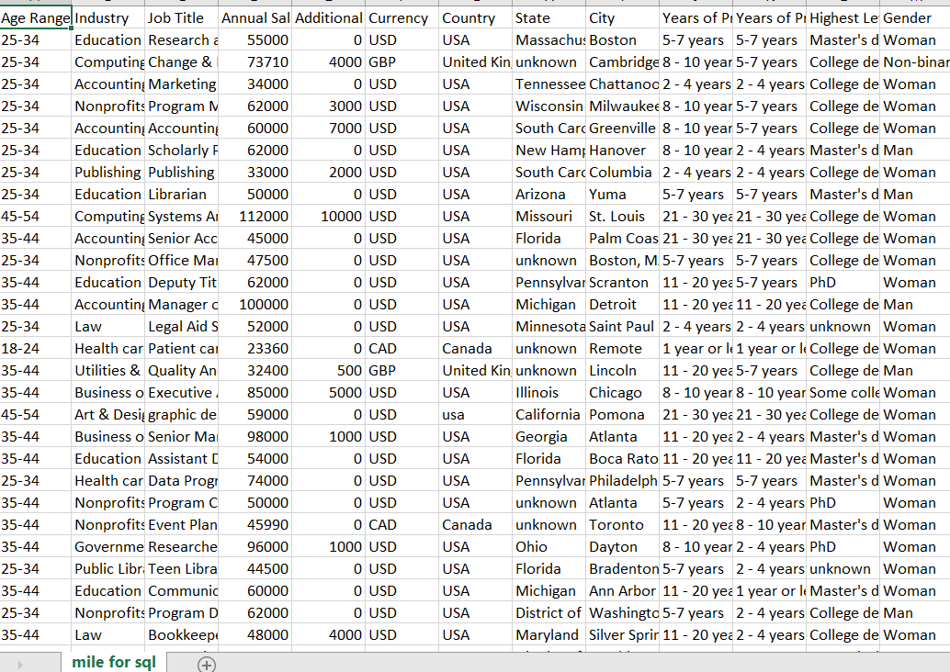
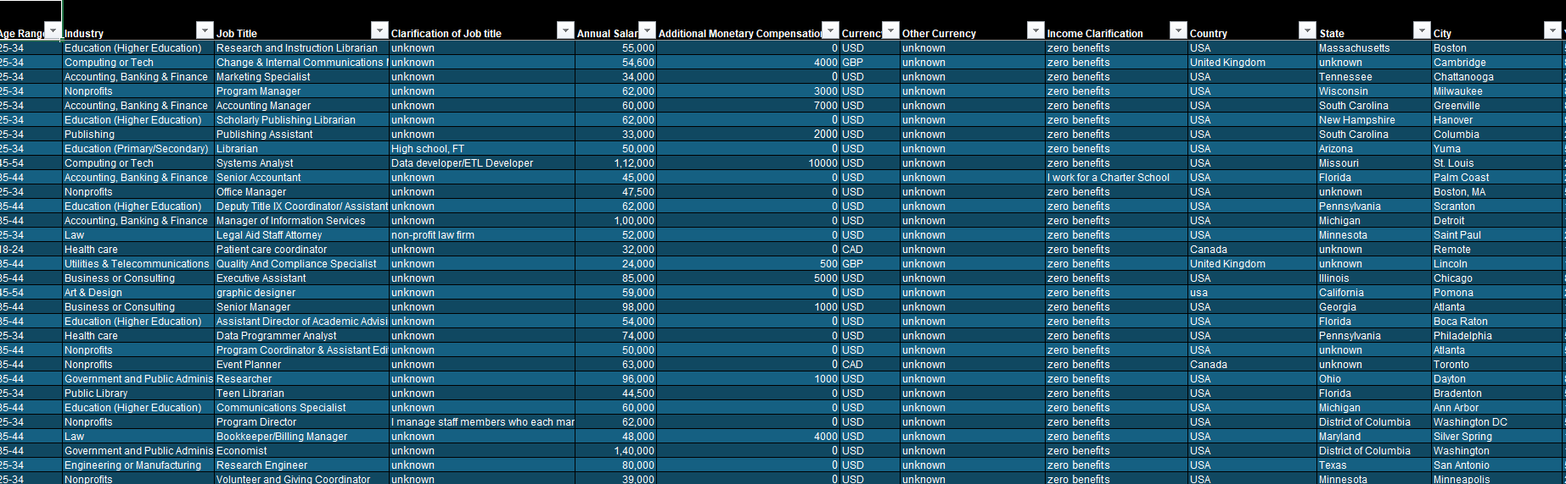
Conversion of raw data to cleaned data
Notes:
The counterargument should be the most common argument against the topic. The goal for this slide is to address the counterargument in such a way as to actually strengthen the original topic. Be sure to address each piece of evidence against the topic. As you address each piece of evidence elaborate on the text found on the slide. Remember to transition to the final slide, the action step.

Slide 5
SQL Setup and Sample Queries

Slide 6
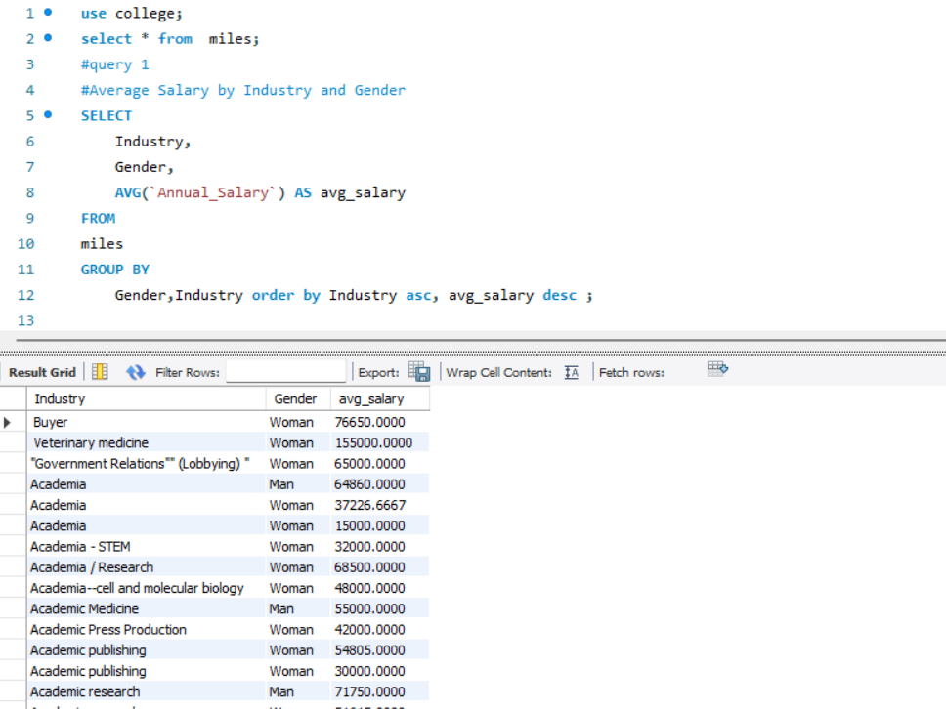
1. Average Salary by Industry and Gender

Slide 7
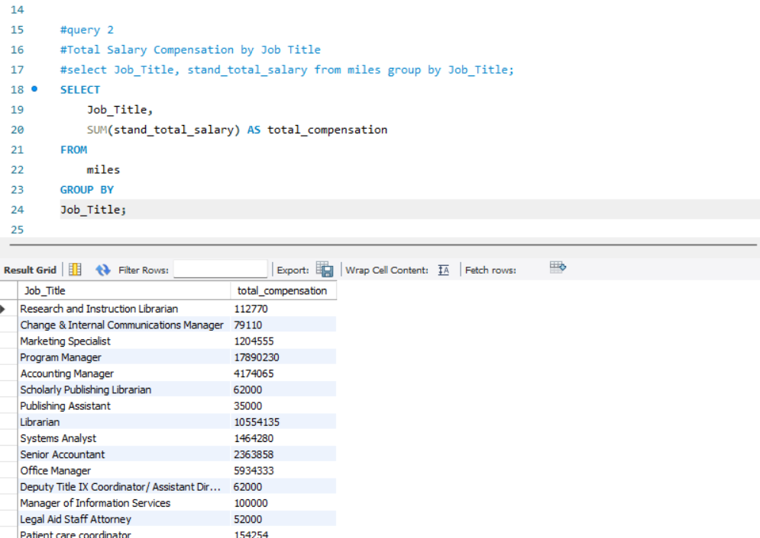
2. Total Salary Compensation by Job Title

Slide 8
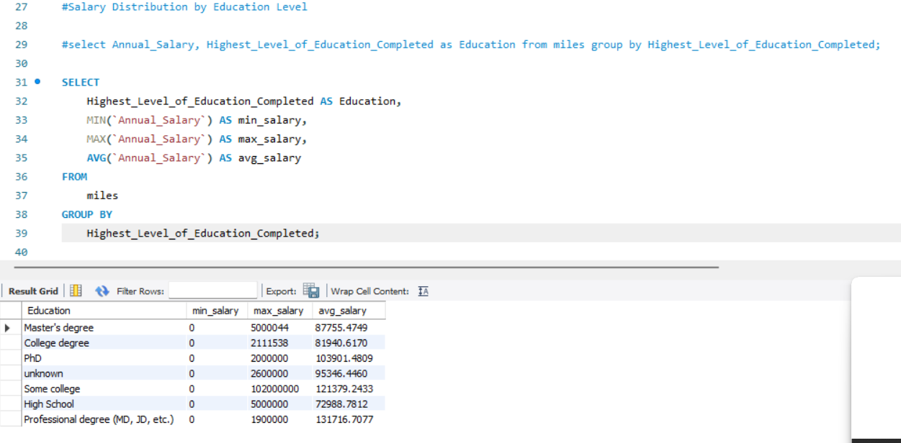
3. Salary Distribution by Education Level

Slide 9
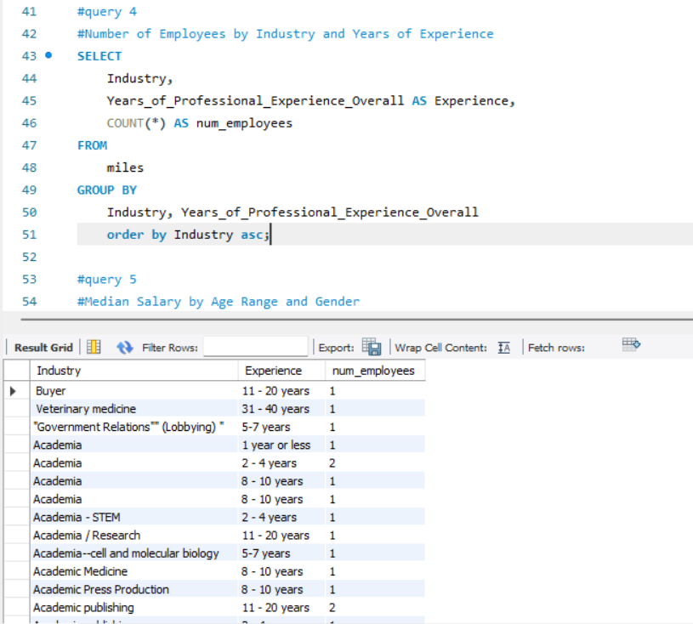
4. Number of Employees by Industry and Years of Experience

Slide 10
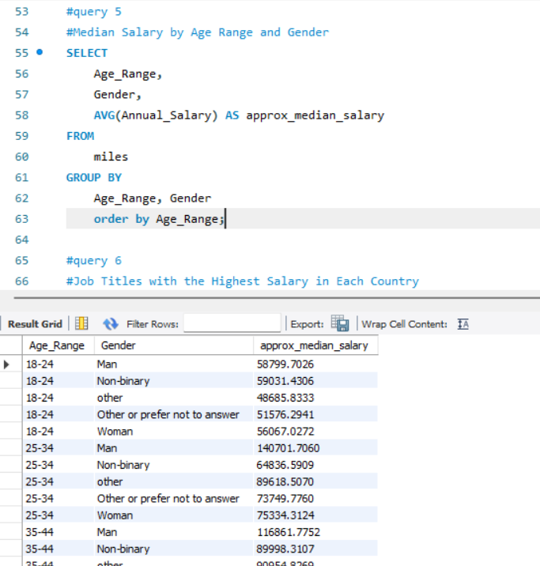
5. Median Salary by Age Range and Gender

Slide 11
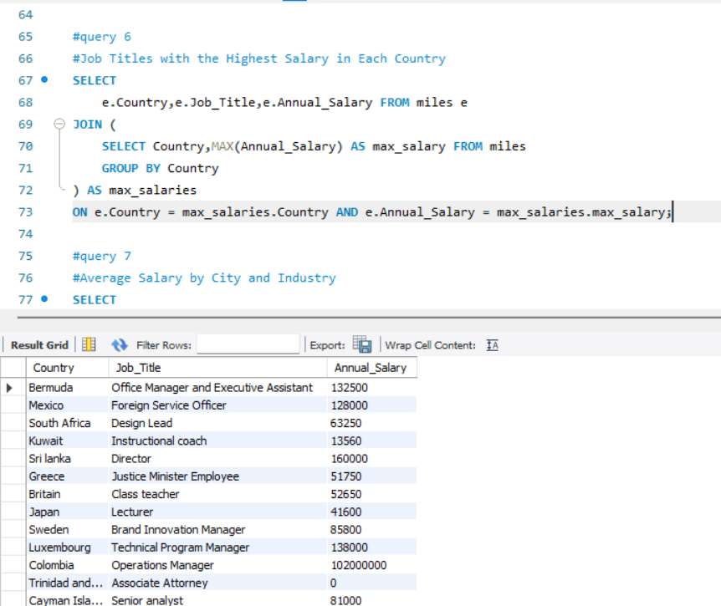
6. Job Titles with the Highest Salary in Each Country

Slide 12
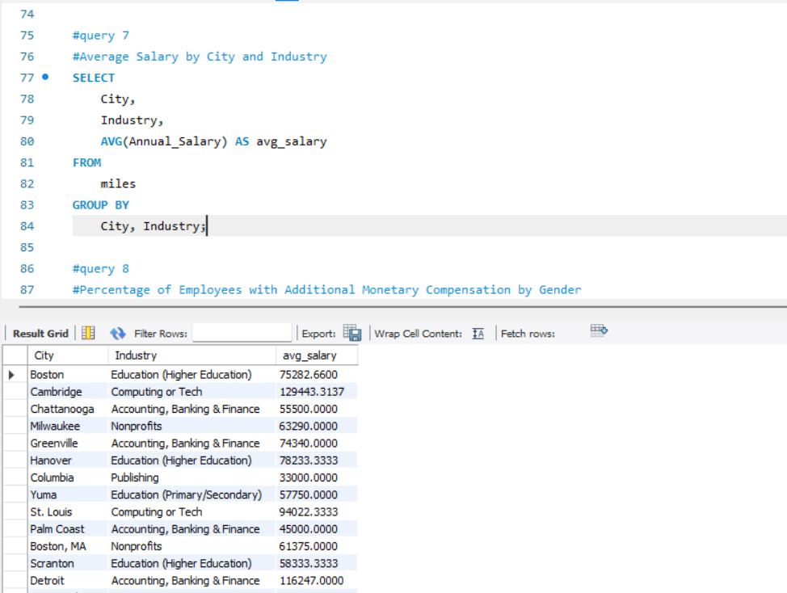
7. Average Salary by City and Industry

Slide 13
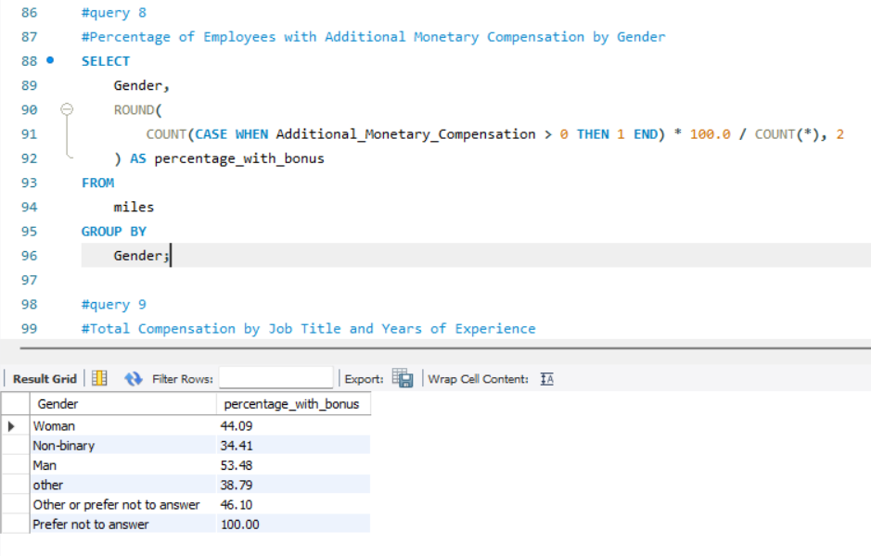
8. Percentage of Employees with Additional Monetary Compensation by Gender

Slide 14
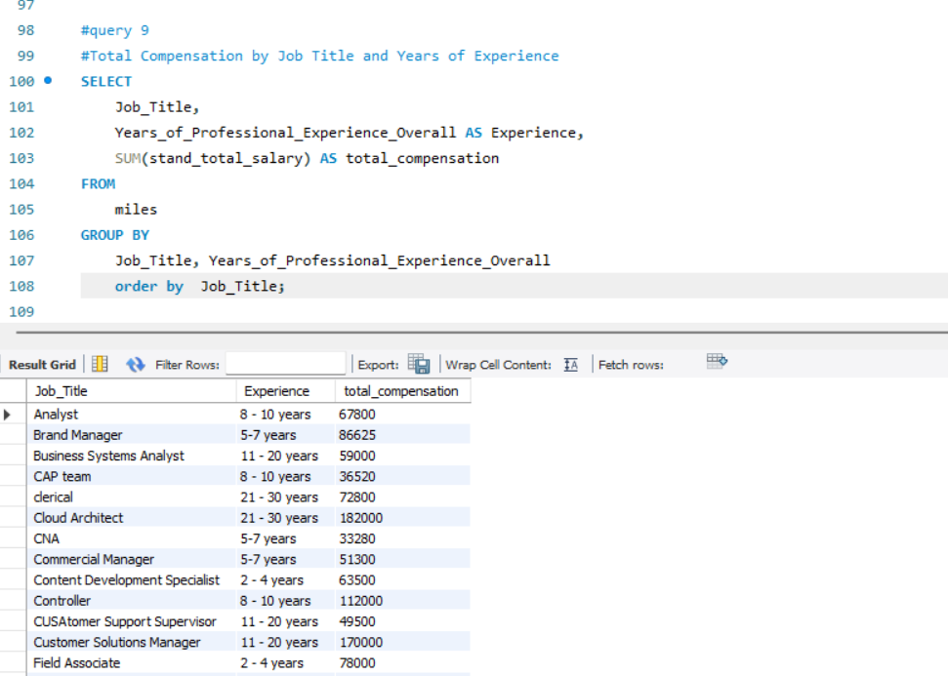
9. Total Compensation by Job Title and Years of Experience

Slide 15
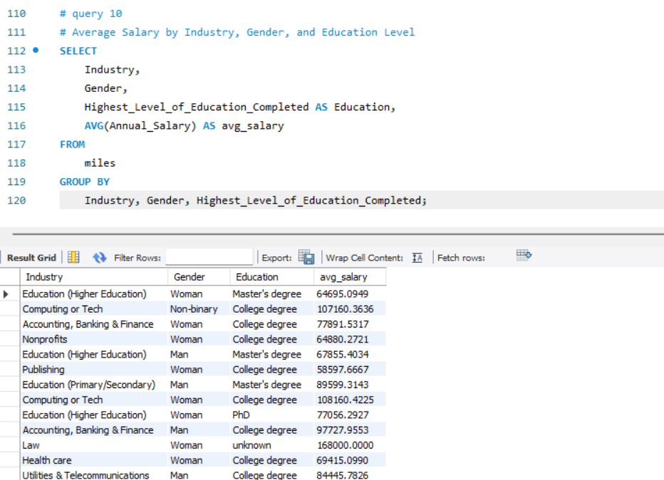
10. Average Salary by Industry, Gender, and Education Level

Slide 16
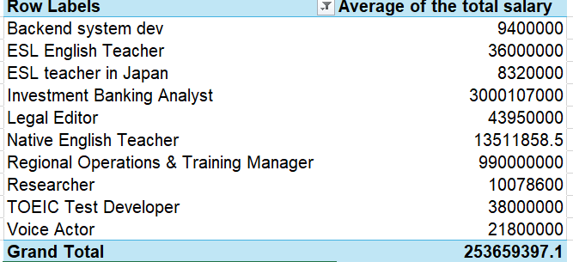
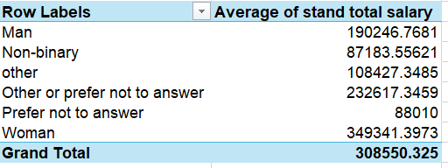
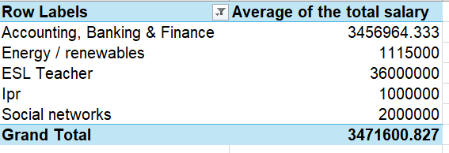
Pivot Table Highlights

Slide 17
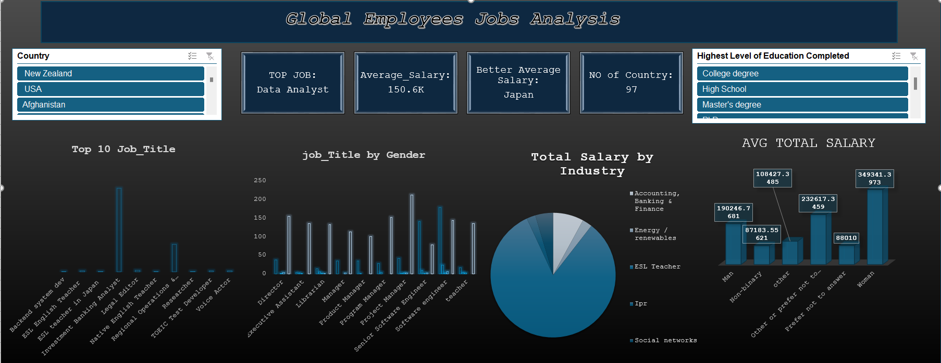
Dashboard

Slide 18
Insights & Trends
Insights:
Age and Gender-based Salary
Education and Salary
Job Title and Experience
Bonus Compensation by Gender
Recommendations:
Promote Equal Pay Policies
Skill-based Learning Focus
Targeted Support for Underrepresented Groups

Slide 19
Conclusion
There is a clear gender-based salary disparity across most industries.
Finance and Tech dominate in total salary paid, but with internal inequalities.
Higher experience and advanced education positively impact salary.
The dataset is positively skewed, so the median salary gives a better center than the mean.
Many roles offer minimal or no additional compensation, highlighting room for better incentives.

Slide 20

ANY QUESTIONS

Slide 21
Thank you

